Slide 1
System Administration
WMS Guide

Slide 2
Table of Contents
Item Load………………….................................................................................................3
Item UOM Maintenance………..…………….…….............................................................28
Item Volumetrics Maintenance.………..…………..…......................................................37
Inventory Volumetrics Maintenance..………..…………………….…...................................44
Item (TMS)………………................................................................................................51

Slide 3
Item Load

Slide 4
Item Load
Items in the WMS are specified with a wide variety of attributes which can be defined through the Item Load resource.
The Item Load resource is similar to the Item Management resource (which is more detailed). The Item Load resource has been customized to reflect the minimum fields required for item configuration in the WMS.

Slide 5
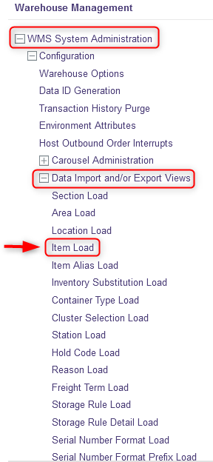
Item Load
With a desktop computer, use the Warehouse Management menu.
Select the WMS System Administration resource.
Under WMS System Administration, click on Data Import and/or Export Views.
Under Data Import and/or Export Views, click on Item Load.

Slide 6
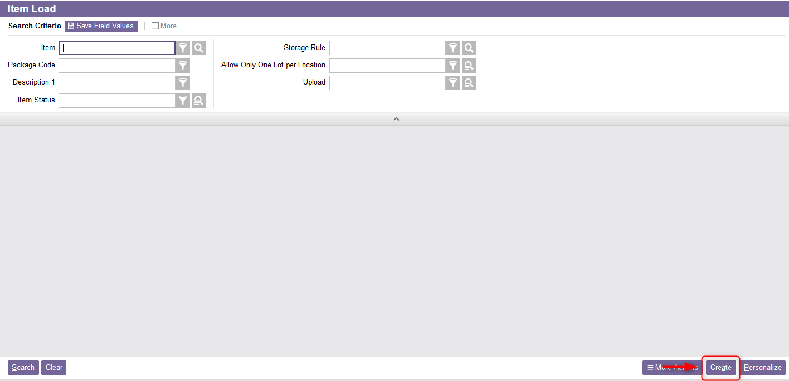
Item Load
From the new window, select the Create action.

Slide 7
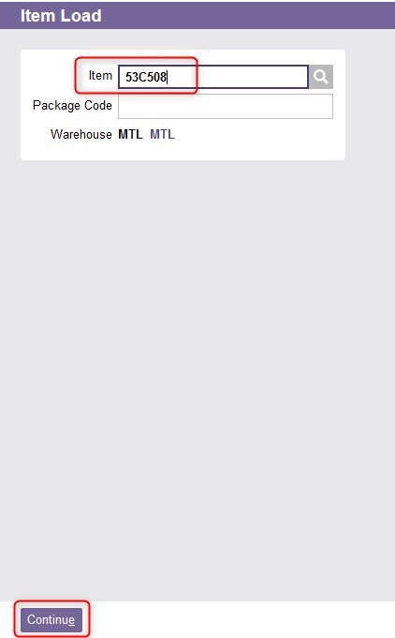
Item Load
A new Item Load window will appear. Enter the Item number you wish to load.
Click Continue.

Slide 8
Item Load
The item's detailed view appears from which you can fill in the various fields required for the following sections:
  General
  UOMs
  Volume and Weight
  Receiving
  Default Input Settings
  Other Information

Slide 9
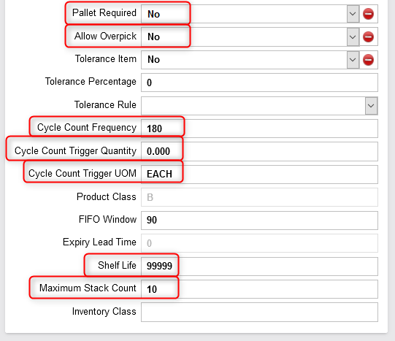
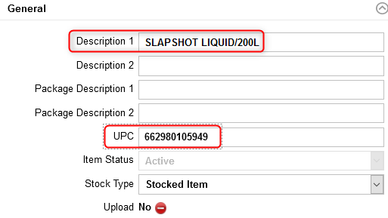
Item Load
Complete the General section at least for the following fields: Description 1, UPC, Stock Type, Pallet Required, Allow Overpick, Cycle Count Frequency, Cycle Count Trigger Quantity, Cycle Count Trigger UOM, Shelf Life , Maximum Stack Count. An explanation of the fields is given in the next slides.

Slide 10
Item Load
(Continued)
Field | Explanation
Description 1 | Short description of the item. This is the description that appears on mobile equipment for commands involving inventory of this item.
UPC | The universal product code for this item. This value is usually downloaded from the DMS.
Pallet Required | A value of Yes indicates that the system consider that the item is always a palletized unit load, regardless of the actual quantity to be stored. A value of No indicates that there is no special pallet requirement for the item.
Allow Overpick | Usually this field is set to No except for packaging or labels. A value of Yes indicates that the item may be over-picked. If allowed and 90% of a pallet is to be picked, the user may choose to pick the whole pallet rather than break the pallet at the point of picking. The product may be relocated through the Inventory Relocation or the Move resources. A value of No indicates that the system will not allow a user to pick more than the ordered quantity for the line item.

Slide 11
Item Load
(Continued)
Field | Explanation
Cycle Count Frequency | The number of days between automatically scheduled cycle counts for an item.
Cycle Count Trigger Quantity | The cycle count trigger quantity for an item. Default value is 0. When a pick or replenishment is performed from a location, and the remaining quantity in the location is less than or equal to this trigger quantity, the system automatically generates a cycle count for the location.
Cycle Count Trigger UOM | The unit of measure for the quantity specified in the Cycle Count Trigger Quantity field.
Shelf Life | The shelf life, in number of days of the item. Usually the value is set to 99999.
Maximum Stack Count | The maximum number of loads that can be stacked vertically in a location. Example: The number of pallets which can be stacked on top of one another.

Slide 12
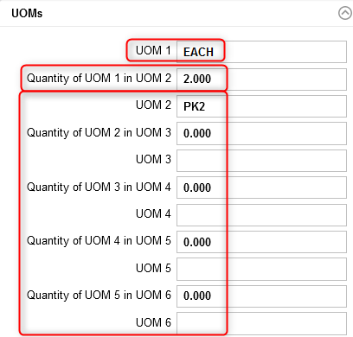
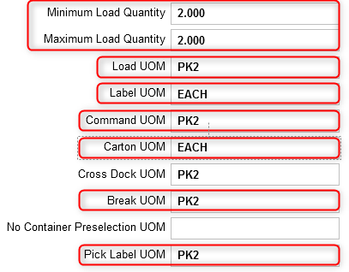
Item Load
If you are loading a new item, complete the UOM section. If you are updating an item for which there is inventory in the warehouse, this section cannot be edited in the Item Load resource, refer to the Item UOM Maintenance section of this document to update these fields. An explanation of the fields is given in the next slides.
Automatically calculated by the system
Mandatory
Optional

Slide 13
Item Load
(Continued)
Field | Explanation
UOM 1 | The level 1 unit of measure. This field is mandatory.
Quantity of UOM 1 in UOM 2 | Given that UOM 1 is the stocking unit of measure, the number of UOM 1 it takes to make one UOM 2.
UOM 2 to 6 | These fields are optional. The level 2 to 6 unit of measure. If specified, UOMs 1 to 6 must be unique.
Minimum Load Quantity | The minimum quantity (in the lowest unit of measure) of inventory that can be associated with a full load for the item. This field is automatically calculated by the system based on the Load UOM field.
Maximum Load Quantity | The maximum quantity (in the lowest unit of measure) of inventory that can be associated with a full load for the item. This field is automatically calculated by the system based on the Load UOM field.

Slide 14
Item Load
(Continued)
Field | Explanation
Load UOM | Quantity per Tag which defines the unit of measure for which a tag ID is generated. The load unit of measure is the item's normal handling unit of measure that controls the creation of unique tags and inventory records at the time of receiving. This value must represent either UOM 1, UOM 2, UOM 3, UOM 4, UOM 5 or UOM 6.
Label UOM | The unit of measure for which tag labels are printed on a receipt record. The label unit of measure controls the number of bar code license plate tags generated at receiving. Label UOM should not be confused with Load UOM since a single unit load could generate many labels, each with the same tag ID. In this example, 2 labels will be generated because the value is set to EACH for a pack of 2. This value must represent either UOM 1, UOM 2, UOM 3, UOM 4, UOM 5 or UOM 6.
Command UOM | The command unit of measure controls how quantity information is communicated to users for all work-related tasks (e.g. picking or store using a RF gun. Commands are displayed to users in this unit of measure whenever possible.

Slide 15
Item Load
(Continued)
Field | Explanation
Carton UOM | Unit of measure that defines a shipping carton that can be shipped directly to a customer as is. It is used to calculate the number of cartons on shipping paperwork (i.e. the bill of lading). This value must represent either UOM 1, UOM 2, UOM 3, UOM 4, UOM 5 or UOM 6.
Cross Dock UOM | The minimum unit of measure that can be cross docked for an item. This field is not used.
Break UOM | The lowest unit of measure allowed when picking this item.
Pick Label UOM | The largest unit of measure for which a pick label will be printed. Example: if the command unit of measure is PALLET, and the pick label unit of measure is CASE, when a pallet is required (with10 cases per pallet), therefore 10 labels will be printed for the pallet. This value must represent either UOM 1, UOM 2, UOM 3, UOM 4, UOM 5 or UOM 6, may not be greater than the Command UOM and not be less than the Break UOM.

Slide 16
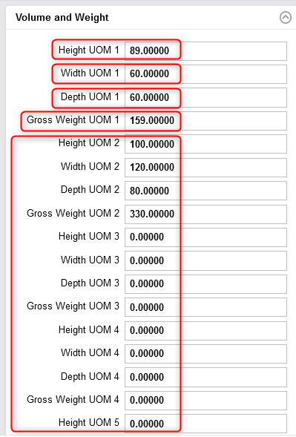
Item Load
If you are loading a new item, complete the Volume and Weight section. If you are updating an item for which there is inventory in the warehouse, this section cannot be edited in the Item Load resource, refer to the Item Volumetrics Maintenance section of this document to update these fields. An explanation of the fields is given in the next slides.

Slide 17
Item Load
(Continued)
Field | Explanation
Height UOM 1 | The level 1 height of the specified unit of measure inventory.
Width UOM 1 | The level 1 width of the specified unit of measure inventory.
Depth UOM 1 | The level 1 depth of the specified unit of measure inventory.
Gross Weight UOM 1 | The level 1 gross weight of the specified unit of measure inventory.
If the corresponding UOM is entered for the Height UOM 1, Width UOM 1, Depth UOM 1 and Gross Weight UOM 1, then the corresponding height/width/depth must also be entered. These fields are mandatory.
Height UOM 2 to 6 Width UOM 2 to 6 Depth UOM 2 to 6 Gross Weight UOM 2 to 6 | These fields are optional depending on whether you entered a value for UOM 2 to 6. The explanation is the same as above.
Notes:
:

Slide 18
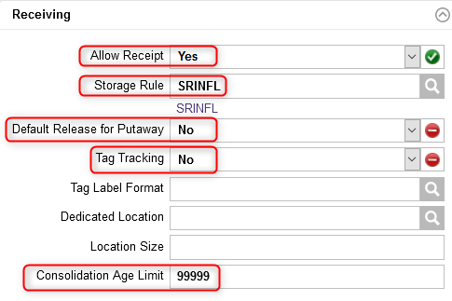
Item Load
Complete the Receiving section for the fields shown below. An explanation of the fields is given in the next slide.
Always set to Yes
Always set to No
Set to No

Slide 19
Item Load
(Continued)
Field | Explanation
Allow Receipt | A value of Yes indicates that inventory of this item may be received in the warehouse. A value of No indicates that inventory of this item cannot be received. This field is always set to Yes.
Storage Rule | This is the storage rule to follow when an item is received. Storage rules instruct the WMS how to find a storage location to support the putaway process.
Default Release for Putaway | A value of Yes indicates that the item will be released for storage automatically during receiving. A value of No indicates that the item will not be released for storage. By setting this value to No, the inventory will be temporarily placed on hold until the user releases manually the inventory for putaway via the Release for Putaway resource. This field is always set to Yes.
Tag Tracking | A value of Yes indicates that the item is tag-tracked. This field is set to No as the tag tracking is usually done at the location level.
Consolidation Age Limit | The relative age, in number of days, that is used for consolidation. During location selection, inventory will not be consolidated with other inventory that differs in age by more than the consolidation age. The value given to this field is always the highest.

Slide 20
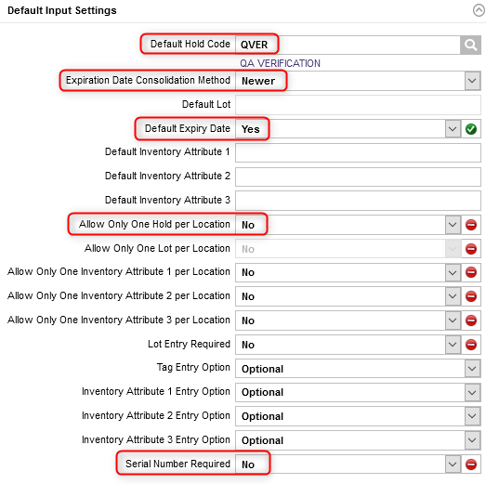
Item Load
Complete the Default Input Settings section for the fields shown in the opposite figure. An explanation of the fields is given in the next slide.
Set to Yes
Always set to Yes
Field downloaded from the DMS

Slide 21
Item Load
(Continued)
Field | Explanation
Default Hold Code | The default hold code to be used for the item during receiving. For some reason, this enables to keep separate the item from similar inventory for Quality Check or in the event of a new item for example.
Expiration Date Consolidation Method | This is used when updating the item's expiration date when the inventory is being consolidated. “Destination” indicates that the inventory will be updated with the item expiration date of the inventory record currently in the destination location being consolidated. “Older” indicates that the inventory will be updated with the older item expiration date of the inventory records being consolidated. “Newest” indicates that the inventory being consolidated will be updated with the newer item expiration date of the inventory records being consolidated. Example: By indicating "Newest", if a product currently in stock received last week is mixed with the same product received this week, then the expiration date will be that week.

Slide 22
Item Load
(Continued)
Field | Explanation
Default Expiry Date | A value of Yes indicates that the item expiration date will be equal to the receipt date plus the shelf life. A value of No indicates that the item expiration date must be entered by the user. This field is set to Yes.
Allow Only One Hold per Location | This determines whether the inventory can be stored in a location that already has inventory or if it needs to be placed in another location. This field is always set to No. A value of No indicates that any hold code can be placed into the location with the same item.
Serial Number Required | A value of Yes indicates that a serial number is required for this item. A value of No indicates that a serial number is not required for this item. This value is downloaded from the DMS

Slide 23
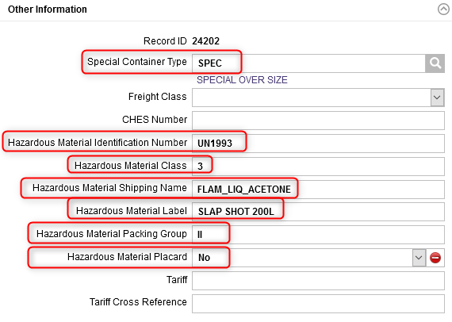
Item Load
In the case of a hazardous material only, complete the Other Information section for the fields shown below. An explanation of the fields is given in the next slide.
Provided by the MSDS
Provided by the MSDS
Managed by the TMS, always set to No

Slide 24
Item Load
(Continued)
Field | Explanation
Special Container Type | Wave release will always assign this container type for the item during picking and will exclude this item from the regular container.
Hazardous Material Identification Number | The hazardous material identifier provided by the Material Safety Data Sheet (MSDS).
Hazardous Material Class | The hazardous material classification.
Hazardous Material Shipping Name | The hazardous material proper shipping name for this item. Refer to the next slide for more details.
Hazardous Material Label | The description/code used for hazardous labeling for the item.
Hazardous Material Packing Group | The hazardous group material classification provided by the MSDS.
Hazardous Material Packing Placard | A flag that indicates if hazardous placards are required. This field is managed via the TMS and is always set to No.

Slide 25
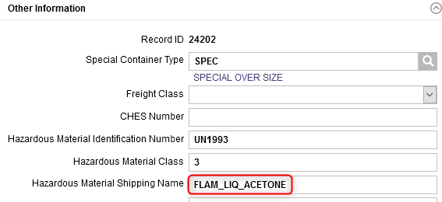
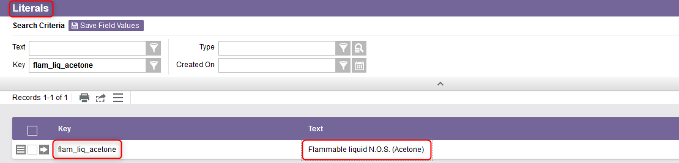
Item Load
Additional Note – The Hazardous Material Shipping Name in the Item Load resource is a code (or key) in the WMS and which refers to a text value. This text value corresponds to the real description of the item for shipping purposes. The real description of the item can be found in the Literals resource.

Slide 26
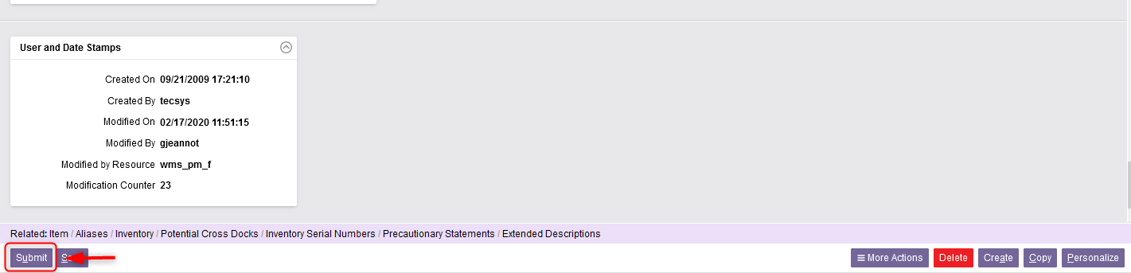
Item Load
Once all the required fields in the sections have been completed, click Submit.
Click Close to exit the Item Load resource.

Slide 27
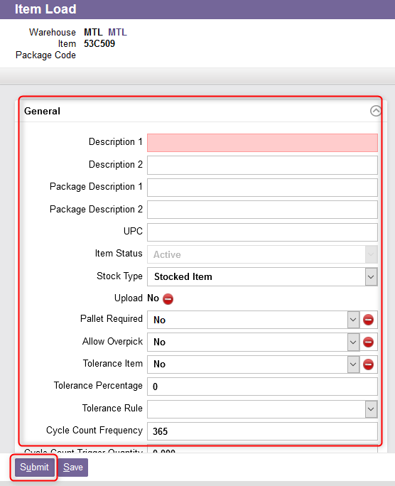
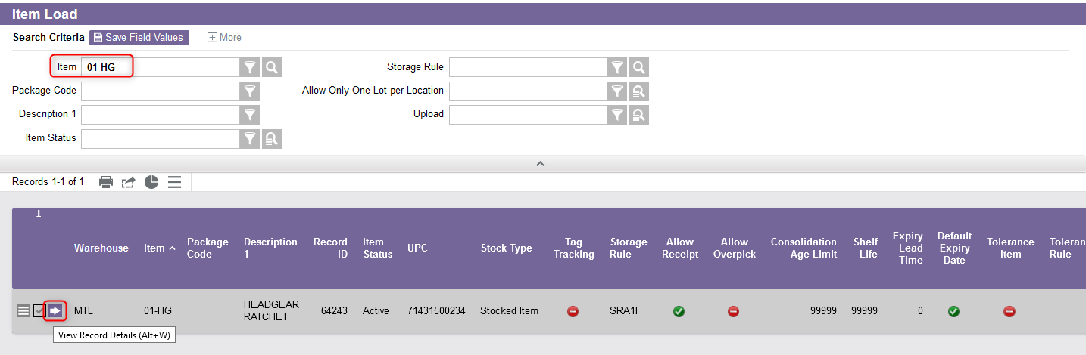
Item Load
Additional Note – If you just want to update data for a particular item, from the Item Load resource:
Perform a search to retrieve the item you wish to update
Select the View Record Details
From the new window, update the desired fields as explained above
Click Submit

Slide 28
Item UOM Maintenance

Slide 29
Item UOM Maintenance
The Item UOM Maintenance view is an item maintenance view that allows modification of item unit of measure (UOM) data even if there is inventory for this item in the warehouse.
This allows for changes to all UOM descriptors except for UOM 1.
The maintenance of UOM is not allowed when there is one or more queued command(s) in the WMS for this item.
Changes to the item UOM descriptors through this view will automatically update all the existing inventory for this item in the system.

Slide 30
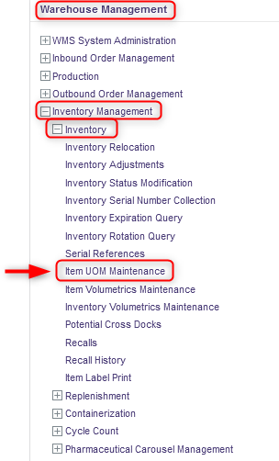
Item UOM Maintenance
With a desktop computer, use the Warehouse Management menu.
Select the Inventory Management resource.
Under Inventory Management, click on Inventory.
Under Inventory, click on Item UOM Maintenance.

Slide 31
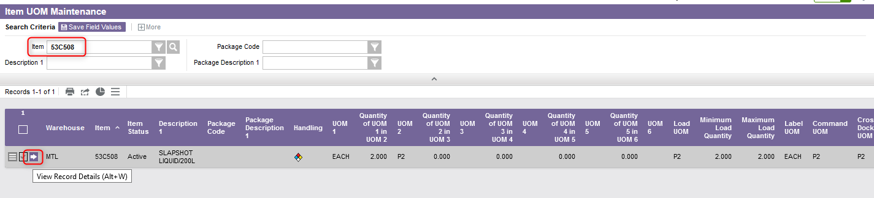
Item UOM Maintenance
Perform a search to retrieve the item you wish to update and click on View Record Details.

Slide 32
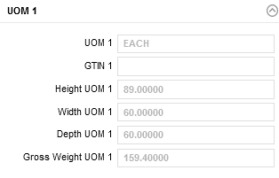
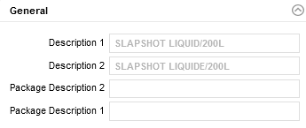
Item UOM Maintenance
In the new window that appears, note that the General and UOM 1 sections will be grayed out and cannot be modified if you are updating an item for which there is inventory in the warehouse.

Slide 33
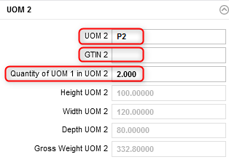
Item UOM Maintenance
In the UOM 2 section, update the desired fields as follows:
The level 2 unit of measure.
The unique identifier for the item's UOM 2 according to the GS1 Global Trade Item Number standards.
The number of UOM 1 it takes to make one UOM 2.

Slide 34
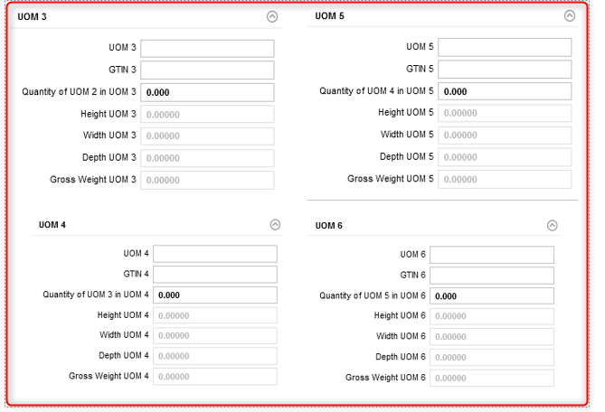
Item UOM Maintenance
Repeat the step 6 for the UOM 3 to UOM 6 sections as needed.

Slide 35
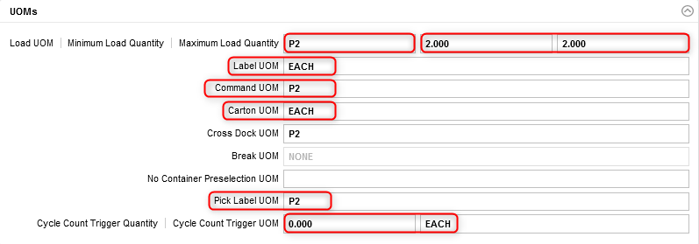
Item UOM Maintenance
In the UOMs section, update the desired fields as follows:
Minimum and maximum quantity (in the lowest UOM) of inventory that can be associated with a full load for the item.
Quantity per Tag which defines the unit of measure for which a tag ID is generated.
UOM for which tag labels are printed on a receipt record.
Commands are displayed to users in this UOM whenever possible.
UOM that defines a shipping carton that can be shipped directly to a customer as is.
Cycle count trigger quantity for an item and its corresponding UOM.
The largest unit of measure for which a pick label will be printed.

Slide 36
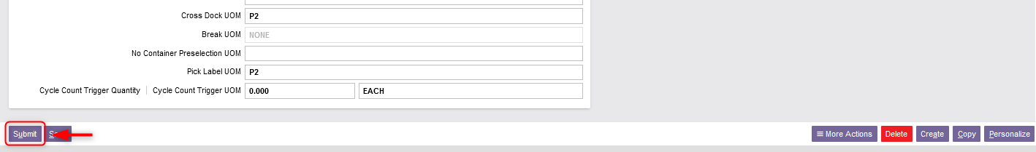
Item UOM Maintenance
Once all the required fields in the sections have been completed, click Submit.
Click Close to exit the Item UOM Maintenance resource.

Slide 37
Item Volumetrics Maintenance

Slide 38
Item Volumetrics Maintenance
The Item Volumetrics Maintenance view is an item maintenance view that enables the modification of item volumetrics data even if there is inventory for this item in the warehouse.
This view allows changes to the dimensions and weight of each UOM.
The maintenance of item volumetrics is not allowed when there is one or more queued command(s) in the WMS for this item.
Changes to the item volumetrics through this view will be applied to all new inventory. If you wish to change some or all the existing inventory records with new volumetrics, this can be achieved through the Inventory Volumetrics Maintenance resource.

Slide 39
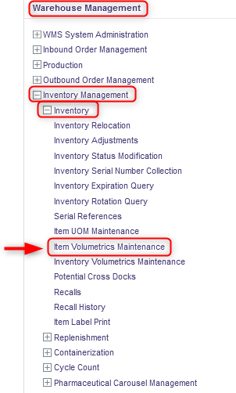
Item Volumetrics Maintenance
With a desktop computer, use the Warehouse Management menu.
Select the Inventory Management resource.
Under Inventory Management, click on Inventory.
Under Inventory, click on Item Volumetrics Maintenance.

Slide 40
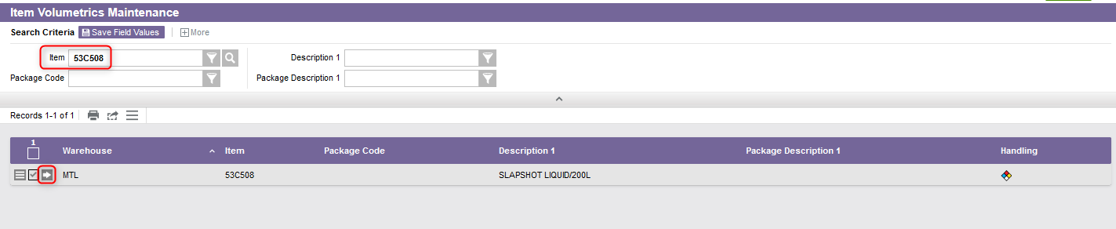
Item Volumetrics Maintenance
Perform a search to retrieve the item you wish to update and click on View Record Details.

Slide 41
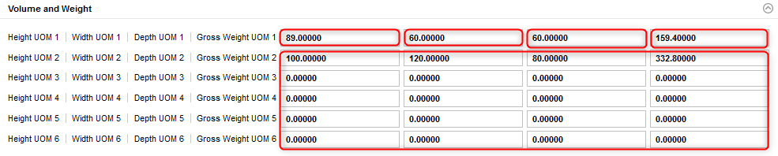
Item Volumetrics Maintenance
In the Volume and Weight section, update the desired fields as follows:
The level 1 height of the specified UOM inventory.
The level 1 width of the specified UOM inventory.
The level 1 depth of the specified UOM inventory.
The level 1 gross weight of the specified UOM inventory.
The level 2 to 6 height/width/depth/gross weight of the specified UOM inventory (if applicable).

Slide 42
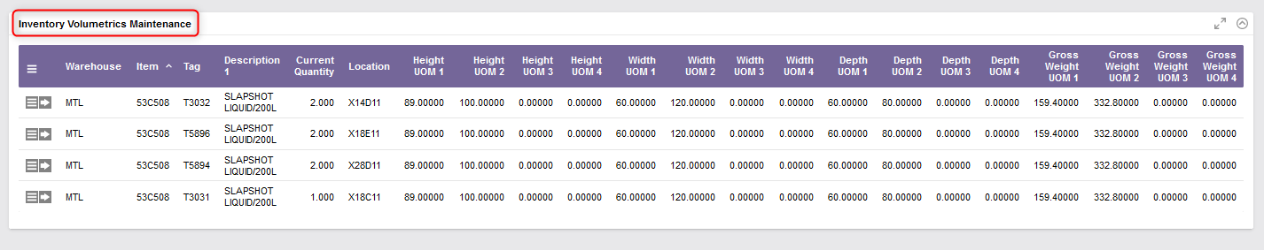
Item Volumetrics Maintenance
Once the Volume and Weight section updated, you also have the option to update the Inventory Volumetrics Maintenance section. Note that this second section corresponds to the Inventory Volumetrics Maintenance resource available in the WMS: refer to the next section of this document to complete this step.

Slide 43
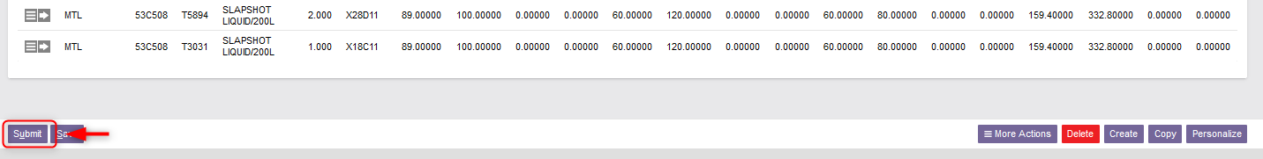
Item Volumetrics Maintenance
Once all the required fields in the sections have been completed, click Submit.
Click Close to exit the Item Volumetrics Maintenance resource.

Slide 44
Inventory Volumetrics Maintenance

Slide 45
Inventory Volumetrics Maintenance
While the Item Volumetrics Maintenance resource (explained in the previous section) will apply the changes to all new inventory, the Inventory Volumetrics Maintenance view allows modification of existing inventory with the current item unit volumetric data.
Therefore, if you wish your old inventory to remain at the same UOM, you should not realize this resource. In this way, having performed the Item Volumetrics Maintenance resource beforehand, only the new inventory received for this item will be updated with the new UOM(s).
Changes to existing inventory that has already been picked is not supported. If required, unpick or repack procedures are required to update this data.

Slide 46
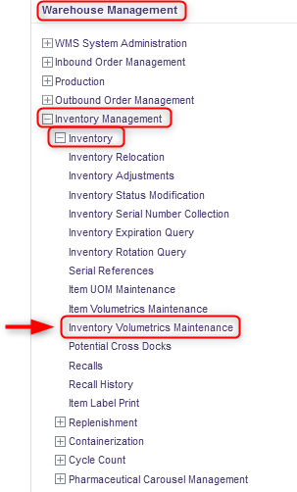
Inventory Volumetrics Maintenance
With a desktop computer, use the Warehouse Management menu.
Select the Inventory Management resource.
Under Inventory Management, click on Inventory.
Under Inventory, click on Inventory Volumetrics Maintenance.

Slide 47
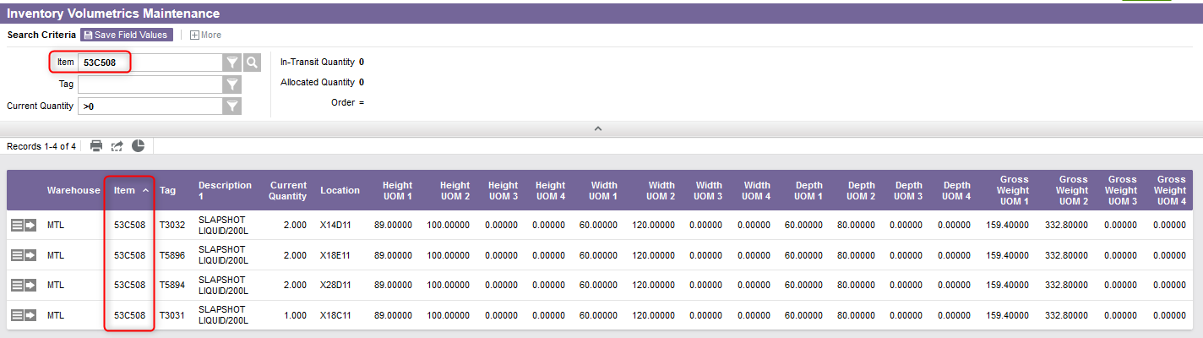
Inventory Volumetrics Maintenance
Perform a search to retrieve the item you wish to update.

Slide 48
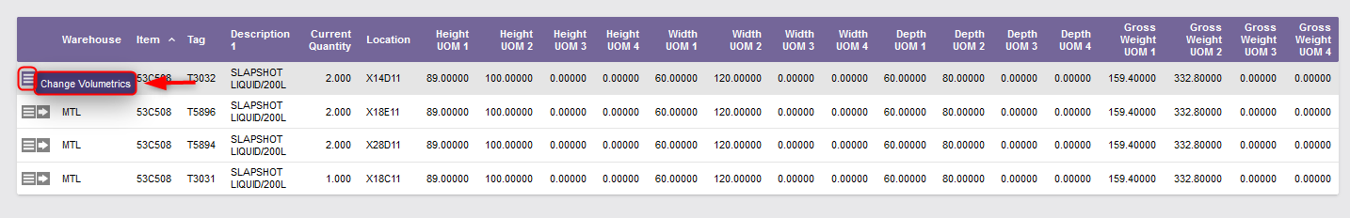

Inventory Volumetrics Maintenance
Choose the line of inventory you wish to update.
Select the Use Record as Criteria for Action button and click on the Change Volumetrics action.
A confirmation message will appear:

Slide 49
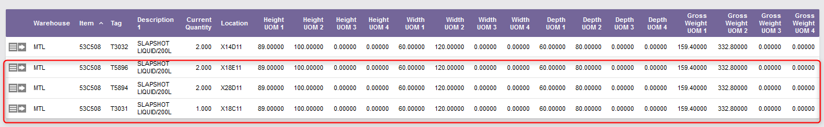
Inventory Volumetrics Maintenance
Perform step 6 for each inventory line of the item for which you wish to update the volumetrics data.
Note: As explained previously, these steps can be performed directly from the Item Volumetrics Maintenance resource if desired.

Slide 50
Inventory Volumetrics Maintenance
Once all the desired volumetrics data updated, click Close to exit the Inventory Volumetrics Maintenance resource.

Slide 51
Item (TMS)

Slide 52
Item (TMS)
The TMS Item resource contains details on products that are to be shipped.
This resource allows you to create an item, to update (add, modify, copy, delete) the record of a specific item or to query the records in the items table if desired.
Data in this table is typically used for Customs documents and LTL bills of lading.
Once captured in the TMS database, this information can be printed (when required) on shipping labels and shown within the system.

Slide 53
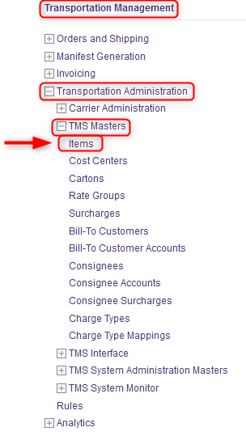
Item (TMS)
With a desktop computer, use the Transport Management menu.
Select the Transport Administration resource.
Under Transport Administration, click on TMS Masters.
Under TMS Masters, click on Item.

Slide 54
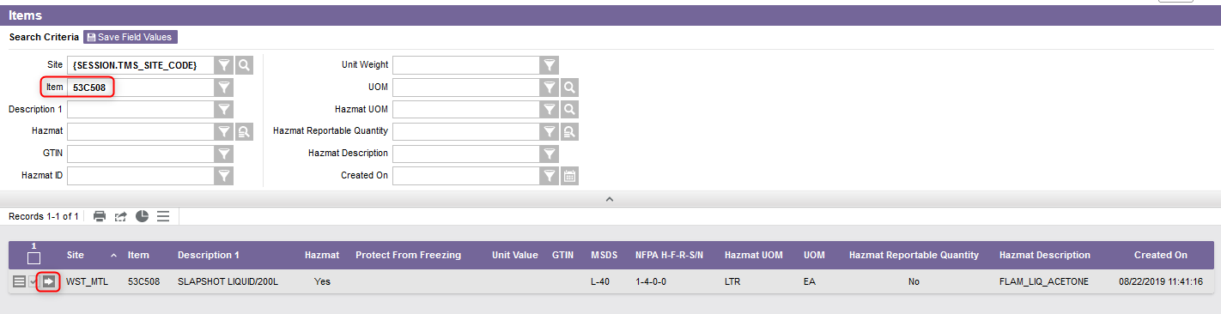
Item (TMS)
To update an item, perform a search to retrieve the item and click on View Record Details.

Slide 55
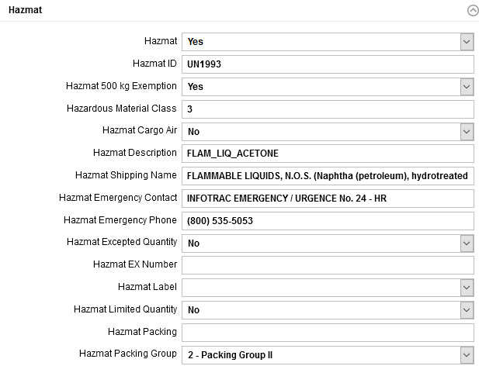
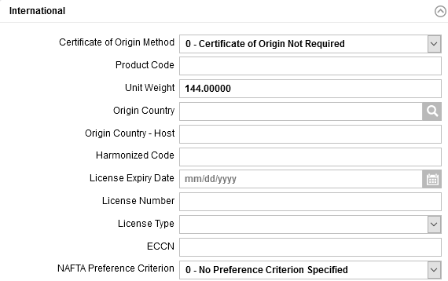
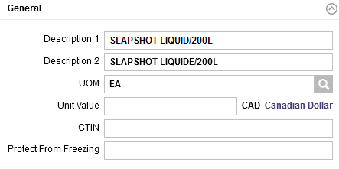
Item (TMS)
From the new window, three sections will appear: General, Hazmat, International.

Slide 56
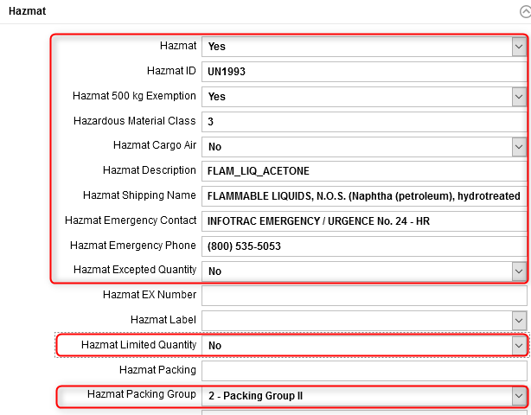
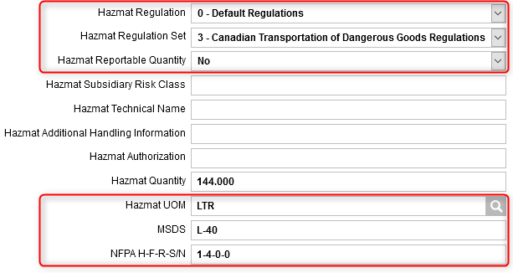
Item (TMS)
Update only the Hazmat section for the fields shown below. An explanation of the fields is given in the next slide.

Slide 57
Item (TMS)
(Continued)
Field | Explanation
Hazmat | Indicate whether Yes or No the item is a Hazmat.
Hazmat ID | The hazardous material identification number for the contents of the package.
Hazmat 500 kg Exemption | Indicate whether Yes or No the 500 kg Exemption applies to the item.
Hazardous Material Class | The hazardous material classification used for the Hazmat. E.g. explosives, gases, flammable liquids, flammable solids, etc.
Hazmat Cargo Air | Yes indicates that the hazardous materials are all packed together in the same packaging. No indicates that the hazardous materials are not packed in the same packaging.
Hazmat Description | A description of the hazardous material.
Hazmat Shipping Name | The hazardous material proper shipping name for this item. Refer to the slide 25 for more details.

Slide 58
Item (TMS)
(Continued)
Field | Explanation
Hazmat Emergency Contact | The hazmat emergency contact (usually the company) name.
Hazmat Emergency Phone | The hazmat emergency phone number.
Hazmat Excepted Quantity | Small quantities of hazardous materials (typically samples) that may be shipped as an exemption to the regulations and just be marked with and Excepted Quantities Mark. Indicate whether Yes or No the Excepted Quantity rule applies to the item.
Hazmat Limited Quantity | The limited quantity is the maximum quantity per inner packaging or article for transporting dangerous goods as limited quantities. Indicate whether Yes or No the Limited Quantity applies to the item.
Hazmat Packing Group | The following options are available: 0 - No Packing Group Specified (default), 1 - Packing Group I, 2 - Packing Group II, and 3 - Packing Group III.

Slide 59
Item (TMS)
(Continued)
Field | Explanation
Hazmat Regulation | The type of regulation to which the hazardous material is subject.
Hazmat Regulation Set | Choose the appropriate regulation from the drop-down menu that applies to the item.
Hazmat Reportable Quantity | The reportable quantities of a Hazmat is the amount of that substance that has to be released before the Environmental Protection Agence requires notification to go to the National Response Center. These quantities are based on volume. Indicate whether Yes or No this applies to the item.
Hazmat Quantity | Indicates the net quantity of the hazardous materials shipment being shipped.
Hazmat UOM | The unit of measure associated with the hazardous material quantity specified.
MSDS | The identifier of the Material Safety Data Sheet associated to the item.
NFPA H-F-R-S/N | The NFPA number associated to the item.

Slide 60
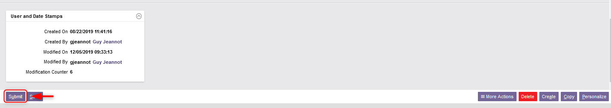
Item (TMS)
Once all the required fields in the Hazmat section have been completed, click Submit.
Click Close to exit the TMS Item resource.

